Slide 1
Advancing Gulf Coast Environmental Justice Leadership & Engagement in Open Science
(AGEJLE-OS)
First convening of community open science champions
Feb 16th, 2024

Slide 2
Agenda
Opening and introductions (ice breaker)
Review convening purpose and plan for sessions
S1: Truth, Justice, Beauty – how can openness improve science and advance EJ
S2: Misinformation is free
S3: More ‘we’ science and less ‘me’ science
S4: Protecting privacy and promote data security
S5: Lowering barriers and planning for Open Science
S6: Obtaining the ‘Ethos of Open Science’ badge

Slide 3
Opening
Ice breaker
  Pre-session questionnaire
    Feelings about science (one word)
    Experience with research

Slide 4
Purpose and agenda
Purpose
  Introduce NASA TOPS and go through process of earning first Open Science badge
  Begin process of clarifying, editing, reframing, and adding to Open Science concepts so that they are relevant to EJ communities
  Identify EJ-OS research priorities and begin process of adapting or substituting existing OS capacity development materials and OS tools so that they are fit for EJ community-led research purpose
Agenda

Slide 5
Agenda with timing
10:00 –10:30 -- Opening and introductions (ice breaker & coffee)
10:30 – 11:00 -- Review convening purpose and plan for sessions
11:00 – 11:45 -- S1: Truth, Justice, Beauty – how can openness improve science and advance EJ
11:45 – 12:30 -- S2: Misinformation is free
12:30 – 1:30 -- Lunch (provided)
1:30 – 2:15 -- S3: More ‘we’ science and less ‘me’ science
2:15 – 2:45 -- S4: Protecting privacy and promote data security
2:45 – 3:15 -- S5: Lowering barriers and planning for Open Science
3:15 – 3:45 -- S6: Obtaining the ‘Ethos of Open Science’ badge
3:45 – 4:00 – Closing and next steps

Slide 6
S1: Truth, Justice, Beauty – how can openness improve science and advance EJ
Good, Bad, Ugly experiences with research
  Capture key points from experience on post-its in each gbu
  Look for groups and patterns
Reflection on why research is important to EJ
Definitions of terms
  Research
  Science
  Environmental justice
Term sorting next slide

Slide 7
“Open Science is the principle and practice of making research products and processes available to all, while respecting diverse cultures, maintaining security and privacy, and fostering collaborations, reproducibility, and equity.”
The White House Office of Science and Technology Policy Memo, 2022 (adapted)
Research products and processes should be available to all, not just a small subset of experts, particularly if funded with public funds.

Slide 8
S1: Term sorting (put words on postits to sort)
Reproducibility is the primary foundation of ‘scientific’ truth
  Truth is established in divine ways, scientific ways, and potentially other ways
Observations
  Data
  Information
  Measurement
Transformed
  Analysis
  Processing
  Reflection
Results
  Outcomes
Systematic process
  For science that is reproducibility
  For wisdom traditions -- it is discernment.
  Others

Slide 9
S1: continued
What is the link between science and justice?
  Go back to post-its – elaborate examples of justice and injustice
  Locking up data (justice deals with uneven power) – importance of equity
  Procedure – agency, inclusion
  Recognition – rights, diversity, focus on some lives and not others
  Distributional -- disparities in outcomes – something about truth in measurement – thinking about ‘others’ – science concentrates attention and resources on some people, some places, some issues
“Justice requires truth be in the public domain”
  Injustice of institution or group to lock up truth
Justice problem if science is not linked to action
Notes:
Reardon – on the emergence of science and justice
Fisk – Justice is key concept in critical theory

Slide 10
S1: Continued
Justice (disparity)
Beauty (world as it should be)
Truth (world as it is)
Notes:
Assumptions and values that inform our way of knowing -- Sen

Slide 11
S1: cont
What does science need to advance environmental justice?
Thoughts on conventional science and open sceince?
Thoughts on science, reserach, and the work of your organization

Slide 12
S1: test
What societal problems can open science help to address? | Scientific reproducibility crisis. | The practice of open science helps address the reproducibility crisis, for example, by involving community feedback to validate results in a more robust manner. | ‘Why do open science?’ | Identify the ‘societal problems’, ie. the problems identified by???, that os can help address | -low confidence in science -low trust in quality -contradictory results slow decisions

Slide 13
S2: Misinformation is free
Negative impacts of closed science
Examples or current initiatives at openness
Where could openness accentuate the positive and minimize the negatives of science for EJ communities

Slide 14
Characteristics, Consequences, Equity of benefits
Closed Science
Open Science
Questionable research practice
Novel positive results
Excludes groups
Ability to question research practice
Discount science that shows problems, challenges status quo, negative results
Inclusive

Slide 15
Benefits for EJ of
Research plan publishing (pressure to distort results)
Open access to data
Open source software
Open publishing

Slide 16
S2:test
 | Spread of misinformation. | The practice of open science combats misinformation by making results available to the public. | ‘Why do open science?’ |  | -misinformation is free! -pay walls for validated science

Slide 17
S3: More ‘we’ science and less ‘me’ science
Benefits to individual researchers (for the test)
Benefits to science – transparency (for test )
Specific benefits to community-led academic supported EJ research
Communiversity and Open Science

Slide 18
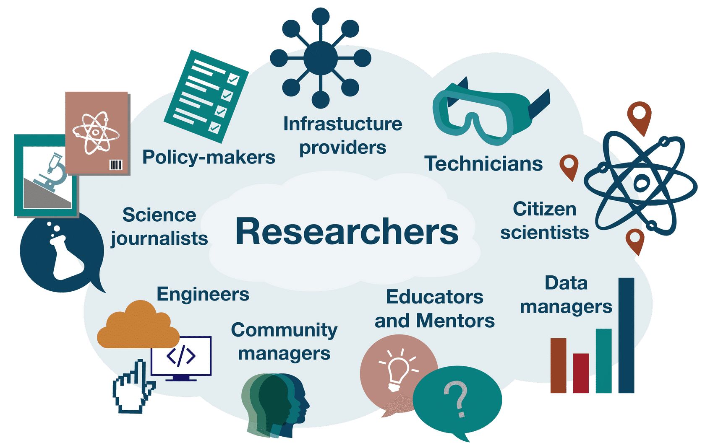
Notes:
Who: researchers -- A team of supporters and collaborators enables this research to take place. Open science aims to include these supporting members of the scientific process and ensure they receive credit for their contribution to improve science.
Who: policy makers: -- Policy makers can also play important roles in ensuring and facilitating open science by setting data management processes, encouraging open access legislation, and developing ethical guidelines for experiments. Policy makers can benefit from open science by gaining better access to scientific output via the open sharing of research results.
Who: public: -- The public plays a crucial role in science today as consumers of scientific results who make decisions based on, and adhere to policies shaped by, scientific results. Open science can make scientific results, data, and workflows more accessible to the public by strengthening routes of access to trustworthy sources of information, which in turn increases trust in science. The public can also take part in open science through community science projects, for example as volunteers to collect or manage data. As a result, participants boost their understanding of science and feel empowered through opportunities to exert influence.

Slide 19
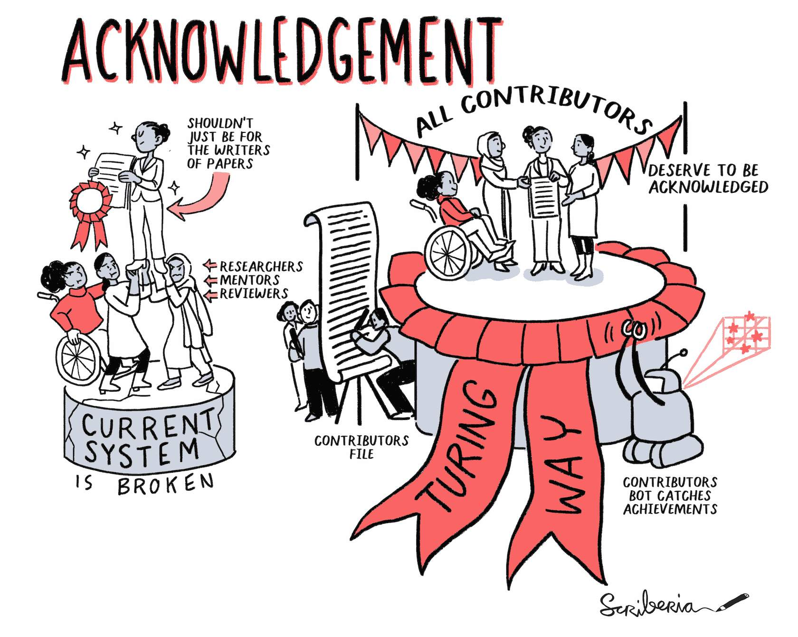

Slide 20
Flip chart with
Benefits to individual researchers (for the test)
Benefits to science – transparency (for test )
Specific benefits to community-led academic supported EJ research
Communiversity and Open Science

Slide 21
S3: test
Open science doesn’t only involve researchers; many other stakeholders are affected by the outcomes of open science. | True: | Open science aims to broaden the traditional scope of who is considered a scientist, so that alongside researchers, there are data managers, infrastructure providers, citizen scientists, science journalists and others who are valued as part of the science ecosystem. | ‘What is open science’ | Identify OS stakeholders. Identify all the different elements of open science

Slide 22
What benefits can individual researchers gain when practicing open science? | Receiving credit for more types of contributions. | Receiving credit for more types of contributions is a benefit that individual researchers can gain when practicing open science. | ‘Why is open science important’ | -identify benefits to researchers -extend this to community-led | “We need more WE science rather than ME science.” Harlan Krumholz, Yale School of Medicine at 2022 CZI Meeting
 | Greater visibility of one’s research. | Greater visibility of one’s research is a benefit that individual researchers can gain when practicing open science.

Slide 23
S4: Protecting privacy and promote data security with different legal tools and guidance on acceptable ways of working
Protections for people and data
Intellectual property -- Copy right, Trademark, Patents, Public domain (for the test)
Licensing – for the test and how to use licensing to advance EJ
Controlled and dangerous to share research – working with partners and oversight

Slide 24
S4: test
Sharing all research products (eg. data, code, results) makes the scientific process less transparent, which may decrease public trust in science. Decide whether the statement above is true or false. | False | Sharing all research products makes the scientific process more transparent which may help increase public trust in science.
Which of the following is NOT a common type of license: Copyright Permissive Creative Commons | Copyright | It gives permission to apply for a license but is not, itself, a type of license.
By applying a license to your work, you make clear what others can do with the things you're sharing, and also establish the conditions under which you're providing them. | True | Licensing is a way to specify under what conditions, if any, others can use, build upon, or distribute your work.
What type of Intellectual Property protection would you need if you created a new way of doing something or offered a new technical solution to a problem? Patent Trademark Copyright | patent | A patent is an exclusive right granted for an invention, which is a product or a process that provides, in general, a new way of doing something, or offers a new technical solution to a problem.

Slide 25
S5: Lowering barriers and planning for Open Science
Fears about open science – for professional and community-based researchers
Incentives for professional and community-based researchers
Technological, social, and other barriers to more openness in community-led OS
Starting a plan

Slide 26
Open science and EJ
Flip chart on
  Fears
  Incentives
  Barriers

Slide 27
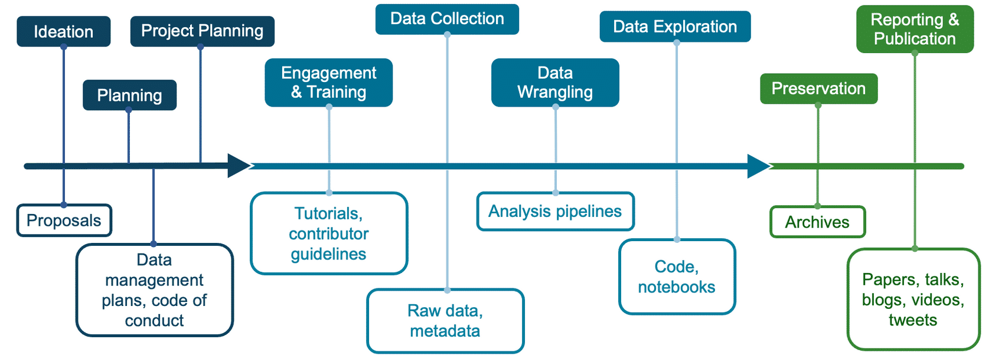

Slide 28
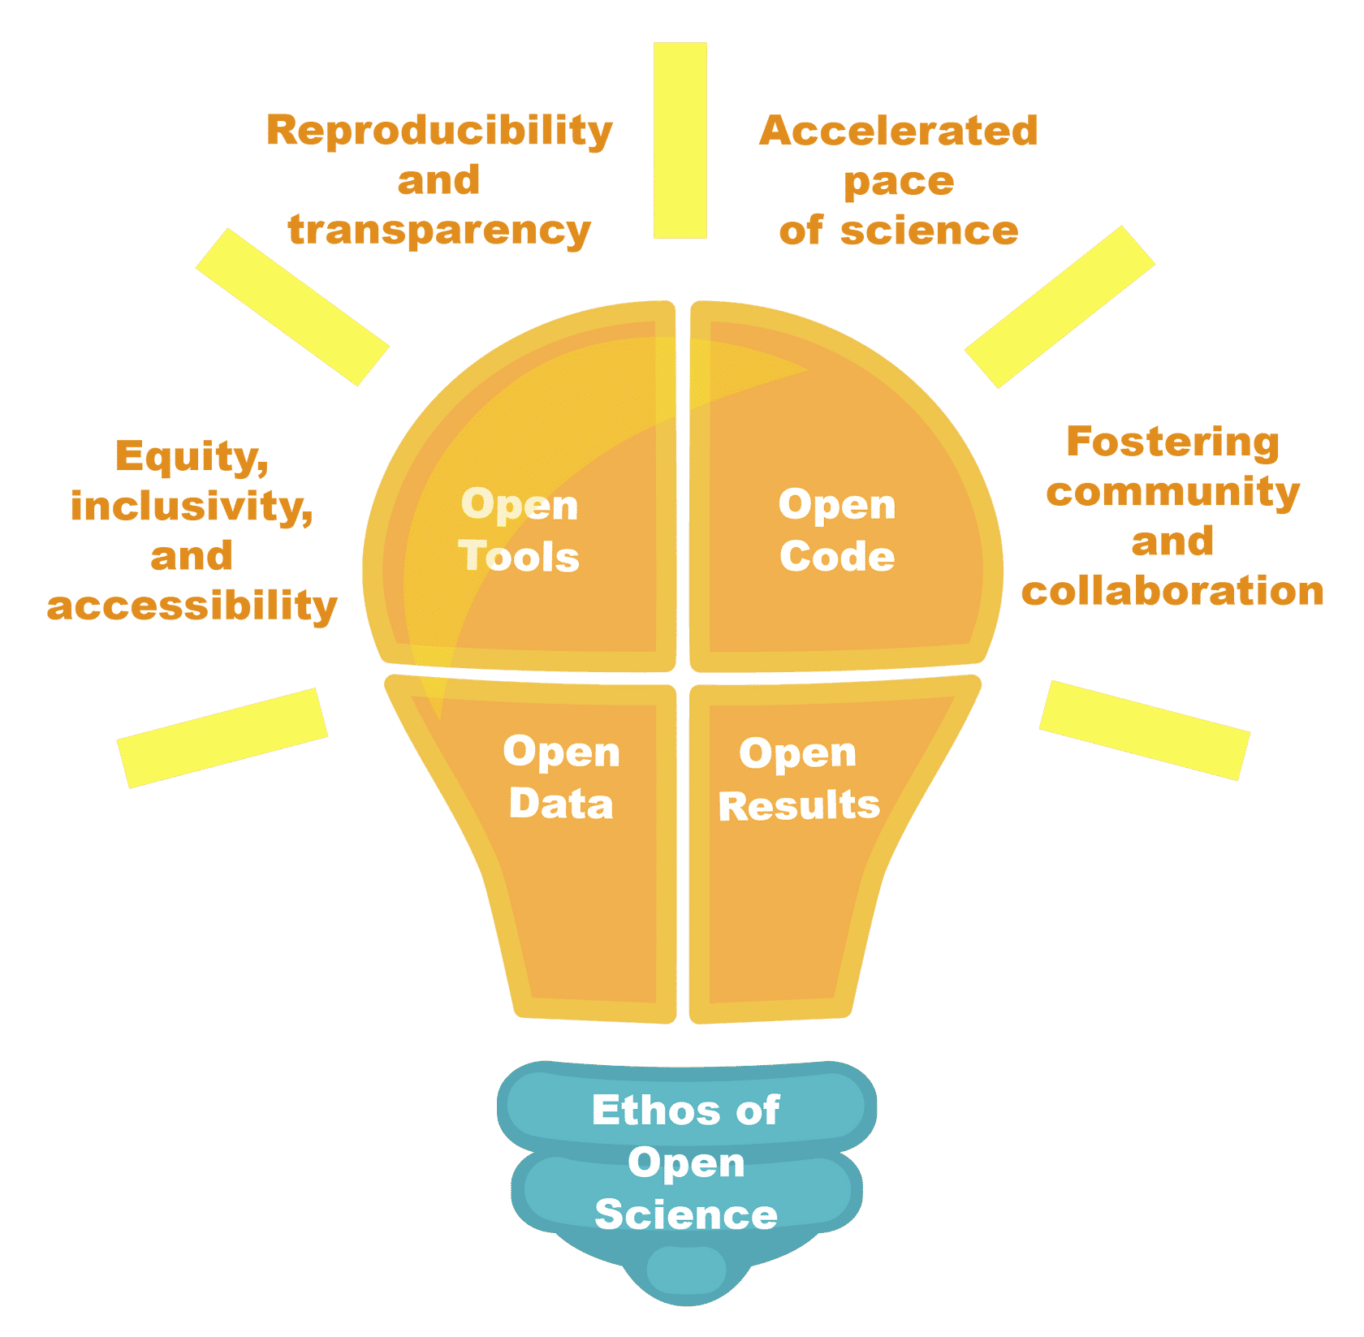

Slide 29
Steps to Open Science that Anyone Can Take
Keep seeking best practices for open science, and develop plans to be more open in your science or research.
Think about all the different types of reviews you are involved with, and how to improve them with a goal of openness.
Ask colleagues about open science activities, and award credit for them in evaluations.
Engage with underrepresented communities to ensure science encourages a more equitable, impactful, and positive future.

Slide 30
S5 Test
All the needed infrastructure is in place to support open science across all disciplines. Decide whether the statement above is true or false. | False | There are many tools and resources for making our code, data, and results more open, but the required infrastructure is still being built, and may not be in place yet to support open science in each discipline.

Slide 31
I’m concerned someone might reuse my work and get the credit. Choose the mitigation strategy that best fits the concern above. -Allow a peer to review your work and correct any mistakes. -Make it difficult for others to cite your work. -Deposit your work early, such as by making a preprint available, and give your data or code a DOI and license. -Provide appropriate documentation for your research products, including descriptions of the data or code, with usage instructions and examples to help others fully understand your work. |  | By depositing your work early, such as making a preprint available before official publication, and assigning your data or code a DOI and license are ways that you can help to protect your work from being reused by others without giving you credit.
Institutions always recognize open science practices when recruiting job candidates and providing training to employees. Decide whether the statement above is true or false. | False | Institutions do not always recognize open science practices when recruiting job candidates and providing training to employees. This can create institutional barriers to individuals wishing to practice open science.

Slide 32
Before starting a project, it is important for researchers to consider how they will collaborate with other researchers, what are the roles and responsibilities, and how and when they will share any materials. Decide whether the statement above is true or false. | True | One of the most important parts of starting a project is thinking about who will work on it, how they will work together, the roles and responsibilities, and how and when they'll share any materials.
Which is NOT a benefit of collaboration on an open software data-processing pipeline? -Decreased duplicative efforts -Contributors get credit for their work -Decelerated data wrangling process -More accurate software | Decelerated data wrangling process | Decelerated data wrangling process is not a benefit.

Slide 33
S6: Obtaining the ‘Ethos of Open Science’ badge
TOPS 101 site and online training registration
ORCHID ID
Opening and completing the online training module

Slide 34
S7: Structured reflection:
How much work needs to be done to ensure OS advances EJ?
What can we plan for and contribute to? Who should we engage to address larger issues?
What are next steps for AGEJLE-OS cohorts?

